Slide 1
Martha’s Vineyard Overview
Notes:
Welcome – names/titles

Slide 2
O U R M I S S I O N
Health Imperatives’ mission is to improve the health and well-being of low-income or vulnerable families and individuals in Southeastern Massachusetts.
Counseling | Medical Care I Advocacy | Education Support Groups I Shelter | Free & Confidential
Notes:
BB

Slide 3
F O U R A R E A S O F F O C U S
Medical Services:
Sexual & Reproductive Health Services
----------------------
Correctional Health Linkage to Care
-----------------------
DYS Primary & Psychiatric Care
Maternal & Child Health Service:
Cape Cod WIC
Plymouth WIC
--------------
South Shore Healthy Families
Cape Cod Healthy Families
---------------
Brockton Young Parents Support
Housing and Economic Security:
Penelope’s Place
-----------------
Housing Search
Employment Supports
Case Management Services
Clinical & Emergency Services:
A New Day Sexual Assault Counseling and Support
----------------------
Human Trafficking Unit
-----------------
SAFEPLAN
Court Advocacy Program
24/7 Emergency Hotline: 508-588-TALK
Notes:
ET

Slide 4
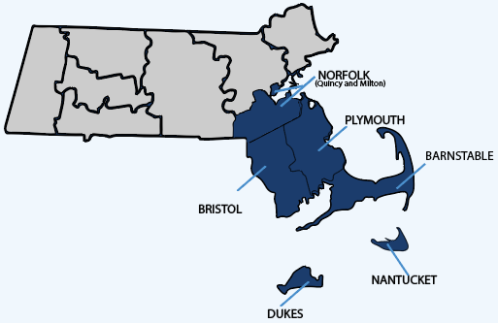
O U R S E R V I C E A R E A
We provide trauma-informed health care and human services
to more than 20,000 people each year throughout
Massachusetts’ South Shore, South Coast, Cape, and Islands.
Regional Office Locations
Brockton
New Bedford
Hyannis
Plymouth
Nantucket
Wareham
Martha’s Vineyard
Notes:
BB

Slide 5
P R I O R I T Y P O P U L A T I O N S
Low-income
Un/under-insured
Adolescents
Immigrants/non-U.S. born
LGBTQIA+ individuals
People with substance use disorders
People with trauma histories, including sexual assault, human trafficking, domestic violence, and sexual exploitation
Notes:
ET

Slide 6
O U R A P P R O A C H
Comprehensive, coordinated services
Trauma-informed, strengths-based care
Free or low-cost services
No one denied services due to inability to pay.
Health navigation
Collaborative partnerships (internal/external)
Outreach to diverse populations
Feedback/input from clients
Notes:
ET

Slide 7
I N T E R N A L C O L L A B O R A T I O N
Sexual and Reproductive Health Care
WIC nutrition
Healthy Families
Notes:
ET/BB

Slide 8
MARTHA’S VINEYARD RESIDENTS SERVED
CY 2022: 1500 total clients
400 WIC participants (women, infants, and children)
1,100 Sexual and Reproductive Health Services patients
2 Healthy Families participants
Approx. 80% <185% FPL
50% Hispanic/Latino; most Portuguese-speaking
40% Limited English Proficiency

Slide 9
S E X U A L & R E P R O D U C T I V E H E A L T H S E R V I C E S
Martha’s Vineyard Sexual & Reproductive Health
Exams
Pregnancy testing
Cancer screenings
Birth control
Gender affirming hormone therapy
STI testing and treatment
HIV prevention medication
HPV Vaccine
Hepatitis C Testing
COVID-19 Vaccine
Notes:
ET

Slide 10
S E X U A L & R E P R O D U C T I V E H E A L T H S E R V I C E S
New Services:
• Narcan education and distribution to prevent opioid overdose fatalities
• Medication for Alcohol and Opioid Use Disorders
• Latent tuberculosis screening
• Medication Abortion services starting July 1

Slide 11
CAPE COD & ISLANDS WIC
WIC Eligibility
pregnant or postpartum women
Families with a child/ children less than 5
Income less than 185% FPL
WIC SERVICES
Access to free and healthy food
Nutrition education
Breastfeeding support
Referrals to a variety of health, economic, and family services and resources
Prenatal Vitamins

Slide 12
HEALTHY FAMILIES
Free home visiting services, coaching, education, transportation, and resources for young parents up to
the age of 26!
Home visitors partner with young parents to help them maintain a safe and caring environment for their children.
Young parents meet with Home Visitors in their homes and learn parenting education and support, the basics of caring
for their child, and how to build positive coping skills.
Young parents learn to anticipate and recognize important milestones in their child’s growth process and understand
how the first years of life impact educational achievement
and long-term health.
Notes:
BB

Slide 13
Website: www.HealthImperatives.org/martha’s-Vineyard/
Facebook: www.Facebook.com/HealthImperatives/CapeCod
Kellie Hicks, Director of Maternal & Child Health: kchicks@healthimperatives.org; (508) 776-2375
Karen Latimer, Sexual and Reproductive Health Services Regional Director: klatimer@healthimperatives.org; (508)292-2036
Betsy Edge, MV SRHS Clinic Director
bedge@healhimperative.org; (508) 693-1209
Notes:
ET/BB

Slide 14
Questions?/Feedback? THANK YOU!

