Slide 1
Hospice & Palliative Care of Martha's Vineyard
Dukes County Health Council
February 16, 2023
Presenters:
Cathy S. Wozniak, MPH, MBA, CHPCA
Chantale Patterson, RN, BSN, CHPN, OCN

Slide 2
Learn about the Mission of Hospice and Palliative Care of Martha’s Vineyard (HPCMV).
Understand our three service lines, the differences between these services, and explore facts and misconceptions about care.
Recognize how Hospice and Palliative Care of Martha’s Vineyard has become the hometown program that residents have turned to for end-of-life care and counseling over our 41- year history on the island and how Medicare certification and accreditation enhances our delivery of services.
Become familiar with current strategic goals and how Martha’s Vineyard community support enhances and maximizes the level of care the team provides.
PRESENTATION KEY TAKE AWAYS

Slide 3
OUR MISSION
Hospice and Palliative Care of Martha’s Vineyard mission is
to provide quality hospice, palliative, and bereavement services to all who are facing serious illness, grief, and the end-of-life. We provide personalized care at home, the hospital and extended care facilities to meet the physical, emotional
and spiritual needs of patients and families.
_______________________________________________________________________________________
FOUNDED IN 1981
And Currently Providing
∗ HOSPICE ∗ PALLIATIVE CARE ∗ COMMUNITY GRIEF COUNSELING &
BEREAVEMENT SERVICES

Slide 4
2022 – A MILESTONE YEAR OF GROWTH
MEDICARE HOSPICE CERTIFIED
NATIONAL ACCREDITATION
ENHANCEMENT OF SERVICES
Now able to serve all Martha’s Vineyard residents and all who have Medicare.
This distinction was awarded through Community Health Accreditation Partner whose standards are above Medicare requirements. Achieved zero survey deficiency.
Through added infrastructure and staffing we now are able to provide increased supports to patients including personal aide services, equipment, medications and participate in quality oversight to meet the highest level of standards.

Slide 5
SOME FAST FACTS ABOUT HOSPICE and PALLIATIVE CARE
25% of deaths occur at home – more than 80% of Americans would prefer to die at home.
HPCMV strives to meet this goal.
Shorter stays make up the majority of hospice care. 25% of patients only receive care 5 days; 50% receive care for only 18 days or less. HPCMV would like to increase access to services sooner.
33.4% are 85+; 28% 74-84; 22.3% are 65-74; and 16.3% are < 65
82% are Caucasian; 8.2% African American; 6.7% Hispanic; 1.8% Asian; .4% Native American; .9% other/unknown. HPCMV has a goal to increase outreach to underserved communities including translation of educational materials.
Approximately 90 million Americans are living with serious illness, and this number is expected to more than double over the next 25 years with the aging of the baby boomers. Martha’s Vineyard is aging faster than the rest of the state of Massachusetts
Hospital readmission costs are a conservative $17.4 billion Effective Quality Hospice care helps to reduce readmission rates managing symptoms at home.
Data resources: MedPac March 2020 Report to Congress, NHPCO Facts and Figures (2021), Center to Advance Palliative Care

Slide 6
SOME COMMON MISCONCEPTIONS ABOUT HOSPICE CARE
Hospice is only for cancer patients
Hospice is for people whose death is hours or few days away
Hospice is giving up or losing hope
Hospice means you must go live someplace other than your home
Hospice means the patient no longer has a say in their care
Hospice patient must sign a DNR
Other medical care is not available to hospice patient or he/she can never return to medical treatment once on hospice
Hospice administers morphine to speed up death
Hospice care ends when the patient dies

Slide 7
OUR DELIVERY IMPACT PAST 3 YEARS AS WE PREPARED FOR MEDICARE 2019-2022
BEREAVEMENT AND GRIEF COUNSELING
HOSPICE AND PALLIATIVE CARE
VOLUNTEER GROWTH- PATIENT CARE, ADMIN. & FUNDRAISING
ADMISSIONS
220 patients served
267 individuals and families served
83 current volunteers
STAFF GROWTH
9 to 20 current day
INFRASTRUCTURE ENHANCEMENTS
*EMR System
*IT Security
*Financial
expertise
*Robust Quality
Program
*PharmD
2022 HOSPICE PATIENT DIAGNOSES
*Cancer – 48%
*Cardiac/Circulatory – 16.35%
*Respiratory – 24.1%
*Alzheimer’s/Dementia – 7.25%
*Nervous System – 23.3%
*Musculoskeletal – 16.7%
*Infection – 10%
*G.I. – 10.6%
*Other – 8.5%

Slide 8
UNDERSTANDING HOSPICE CARE
Provides support and care for those with a life-limiting illness
Recognizes dying as a part of the normal process of living
Affirms life and neither hastens nor postpones death
Focuses on quality of life for individuals and their family caregivers

Slide 9
Person-and-family centered
Interdisciplinary team care
Individualized plan of care and visit schedule
Provides a range of services
*Interdisciplinary case
management – pain &
symptoms, emotional &
spiritual support
*Pharmaceuticals
*Durable medical
equipment
*Supplies
*Volunteers
*Grief support
CORE ASPECTS OF HOSPICE CARE

Slide 10
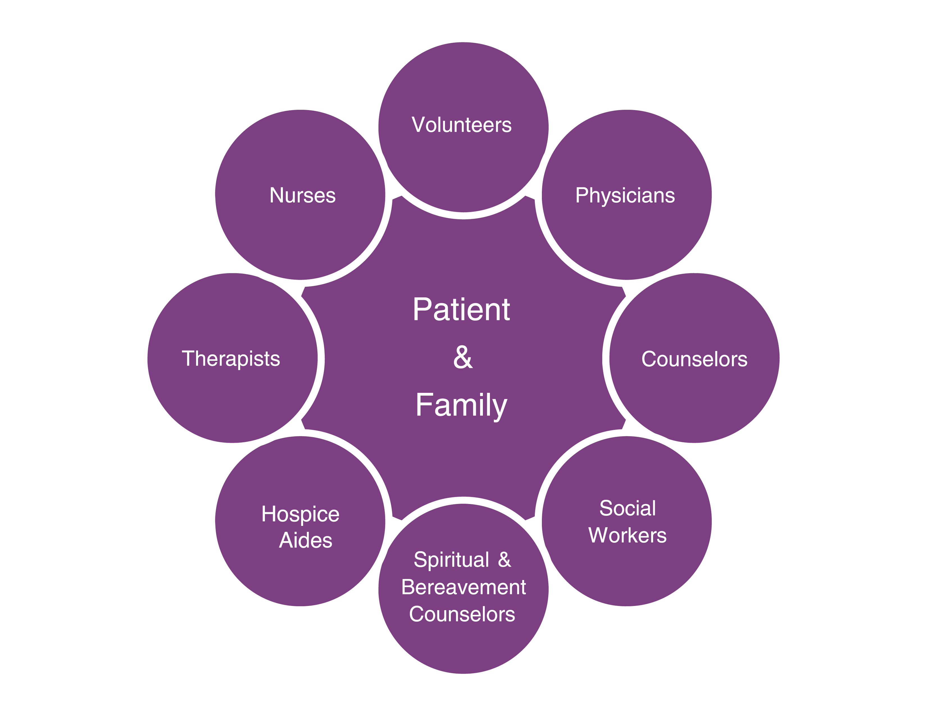
HOSPICE TEAM MEMBERS

Slide 11
WORK OF THE HOSPICE TEAM
Develops the plan of care
Manages pain and symptoms
Attends to the emotional, psychosocial and spiritual aspects of
dying and caregiving
Teaches the family how to provide care
Advocates for the patient and family
Provides bereavement care and counseling

Slide 12
WHERE IS HOSPICE PROVIDED?
NURSING FACILITY
ASSISTED LIVING
HOSPITAL
Home – the patient’s or loved one

Slide 13
ADMISSION CRITERIA AND ELIGIBILITY
To qualify for hospice care, the below are general requirements:
Life-limiting illness; if disease takes normal course six months or less but can be longer if meet hospice medical criteria.
Lives in service area
Consents to accept services
Forgo medical interventions for cure of terminal illness
Common medical eligibility:
Cancer
Circulatory/Heart
Alzheimer’s/Dementia
Respiratory
Stroke
Chronic Kidney Disease
Infection
GI
Other
HPCMV most frequent diagnoses (2022) are CANCER, RESPIRATORY, AND NERVOUS SYSTEM but care for all terminal diagnoses.

Slide 14
ROUTINE HOME CARE
(most common level of hospice care)
High – 1-60 days
Low – 61+ days
GENERAL INPATIENT CARE
(provided for pain control and acute symptom management in a facility)
CONTINUOUS CARE
(provided between 8-24 hours a day for pain and symptom management at patient’s residence – predominately nursing care)
RESPITE
(temporary relief to patient’s primary caregiver provided in Medicare certified facility with RN on-site
SIA (Service Intensity Add-On)
(CMS reimburses hospice for routine services provided by social worker or RN for visits during last 7 days of life
LEVELS OF HOSPICE CARE

Slide 15
WHO PAYS FOR CARE?
Medicare
Medicaid – Mass Health
Insurance AND HMOs
Private Pay
Sometimes a combination
Charity Care and extraordinary needs supported by local donations

Slide 16
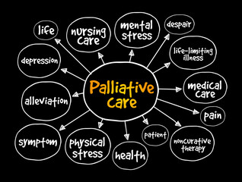
UNDERSTANDING PALLIATIVE CARE – CORE SERVICES
Care that enhances comfort and improves the quality of an individual’s life who is facing a serious illness but may not qualify for hospice care.
The expected outcome is relief from distressing symptoms, the easing of pain, medication management and enhancement of quality of life.
Education on symptoms and disease progression
Advance care planning and MOLST/POLST
Care may be provided with treatments
Connects patients and families with needed resources
Supportive care – psychological, spiritual, social
Common illnesses supported by HPCMV’s palliative program include cancer, cardiac, respiratory, kidney failure, Alzheimer’s, ALS, and more.
Palliative care teams include: physician, NP, social worker, RN support staff, and chaplaincy/bereavement services are available

Slide 17
BENEFITS OF PALLIATIVE CARE
High member satisfaction in quality of care members received with serious illness
Fewer hospitalizations (81%)
Longer lengths of stay in hospice (71.7%)
Decrease in ICU days and hospital mortality rates (86%)
Fewer complications
$12.6K savings per person
Reported by Aetna’s Medicare Advantage Compassionate Care Program (Journal of Palliative Medicine, 25 Oct. 2019)

Slide 18
UNDERSTANDING GRIEF COUNSELING AND BEREAVEMENT SERVICES
HOSPICE AND PALLIATIVE CARE
13 MOS. FOLLOWING DEATH OF PATIENT
Community Grief Counseling & Support
Counseling, family meetings and spiritual care for persons who are ill, those close to persons and caregivers
Advance directives and post death planning
Letters/
Informational
materials, phone
contact,
counseling and
spiritual care
sessions for those
close to the
Deceased
Planning/leading funeral & memorial services
Up to 13 mos, open to all on MV who have experienced a death within previous 2 years
Grief support groups, general and specific
Community crisis response to calls from schools, hospital, MV agencies
Currently increasing capacity to support child and adolescent bereavement

Slide 19
THE HPCMV DIFFERENCE ON MARTHA’S VINEYARD
Independent Nonprofit Hospice with 41 years of experience serving the Martha’s Vineyard community
Serving all patients, including Medicare hospice patients and the only CHAP accredited hospice on the island
A robust on-island interdisciplinary team providing physical, emotional, social, and spiritual support by specially trained and certified staff
Hospice team on-call 24/7 with after hours and weekend availability for referrals
Individualized care plan for patients including general inpatient and respite care, if needed at MV Hospital
Comprehensive bereavement counseling and grief counseling by certified and licensed counselors offering group and individual counseling and memorial services
Enhanced services including pharmacy management through Delta Care Rx with Doctor of Pharmacy oversight, interpreter services in all languages, and full EMR system
Core of on-island volunteers supporting patients/families in variety of ways including vigil sittings, companionship, and errands.

Slide 20
ACCESSING OUR SERVICES
Anyone can call our office directly to inquire about services – loved one, health care professional, friend, neighbor, for example. 508-693-0189 (24/7 availability)
After gathering information, we call the individual’s primary care physician to ascertain if the diagnosis meets hospice eligibility criteria to become a hospice patient.
Upon confirmation of a primary diagnosis for hospice care, if the individual and family wants a consultation, we schedule one and determine if hospice is right for them.
If the patient/family wants to elect hospice benefit, we admit the patient, he/she signs an informed consent which is followed by an initial and comprehensive assessment.
Individualized goals of care are established, and plan of care created. The full interdisciplinary team then moves forward in coordination of care.
If an individual does not meet hospice criteria, he/she is accessed for palliative care and/or referred to other community resources. A plan of care is established for all palliative care patients and in collaboration with patient’s physicians/specialists.
Calls from community individuals needing bereavement services are referred directly to one of our counselors for assessment and follow-up. All hospice families automatically receive 13 months of bereavement follow-up (part of Medicare regulation) and community individuals receive counseling services at no charge based on their need and length of time required.

Slide 21
OUR MAJOR ANNUAL FUNDRAISING EVENTS
SUMMER SOIREE
MEMORIAL DAY ROAD RACE
GOLF TOURNAMENT
HPCMV relies heavily upon philanthropic support. Other events, special appeals, and memorial donations contribute to services.

Slide 22
STRATEGIC GOALS
GROWTH
IMPACT
LEADERSHIP
*Growing our patient census and recruiting staff to access anyone on Martha’s Vineyard needing hospice, palliative care services, and grief support
*Identifying larger office space
*Utilizing grants to align focus areas including
palliative care expansion;
multiple methods of communication about our services;
adding children’s grief counseling; and
supporting respite care for patients/caregiver and staff.
Massage therapy
program is available for
patients/caregivers and
staff
*Enhancing Governance and Board Engagement
*Augmenting culture of advancement/ philanthropy/donor base
*Supporting resilience and mental well-being in the workplace

Slide 23
SOME ONLINE RESOURCES
National Hospice and Palliative Care Organization’s CaringInfo website offers some useful resources with free materials www.CaringInfo.org – with information and tools to help people facing serious illness, including help with advance care planning, caregiving, and grief.
Center for Advanced Palliative Care (CAPC) –GetPalliativeCare.org - articles, patient/family handouts, blogs, podcasts, provider directory
Hospice and Palliative Care Federation of Massachusetts –
www.hospicefed.org – professional and consumer resources,
veteran info, and provider directory
Hospice and Palliative Care of Martha’s Vineyard – www.hospiceofmv.org

Slide 24
Questions

