Slide 1
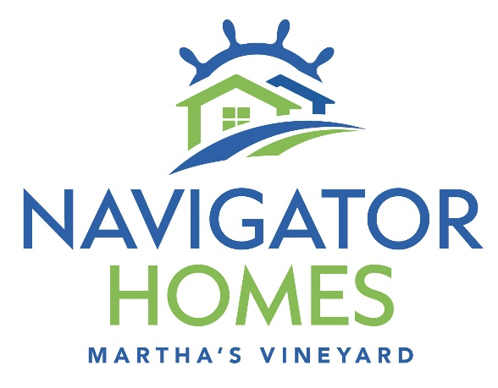
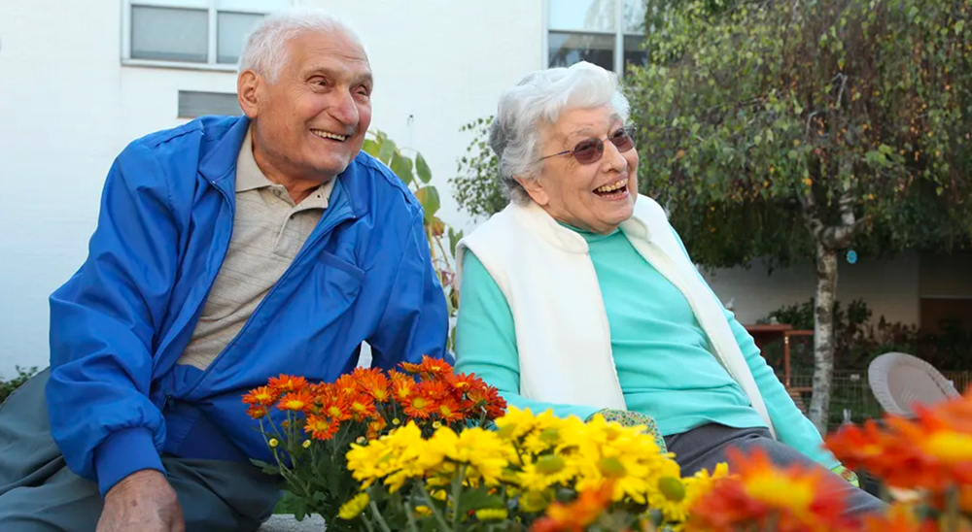
Navigator Homes of Martha’s Vineyard Green House Homes Edgartown, MA

Slide 2
Background
1996 – Windemere was built 26 Years Ago
Windemere Loses $3M/Year because:
90% of Windemere payments are from Medicaid
Medicaid reimbursements do not cover costs
Staff shortages contributed to the financial woes
Windemere is a dated facility and has an institutional care model
MVH subsidizes this loss, detracting from their ability to provide other medical services.

Slide 3
MVH acquired 28 acres at 490 Edgartown Road in Edgartown from the Norton family
MVH issued an RFP for a replacement skilled nursing and rehabilitation center; Navigator Homes of MV was chosen.
2021 Edgartown Town Meeting unanimously approved new zoning for senior housing, including staff housing as an ancillary use to the nursing home.
MVH plans to build staff housing on the site to support both Navigator and MVH staff

Slide 4
All local permits have been approved: 🎉
👍MV Commission , 👍 Board of Health and 👍Planning Board
Mass Department of Public Health Council Determination of Need and architectural plans are approved.
The Building permit is being reviewed by the Edgartown Building Department.
Hebrew Senior Life joined the team as consultant and will manage Navigator Homes. 👏 🎉

Slide 5
Windemere Is To Be Replaced By Navigator Green House
Windemere Institutional Model will close
Vacated Windemere space will be used for new clinical offerings
Navigator to replace Windemere with Green House Model
Core Values of the Green House Model:
Real Home
A Real Home, not an institutional setting
Meaningful Life
A Meaningful Life to enhance elder wellbeing & autonomy
Empowered Staff
Empowered Staff provide hands on care in a collaborative culture

Slide 6
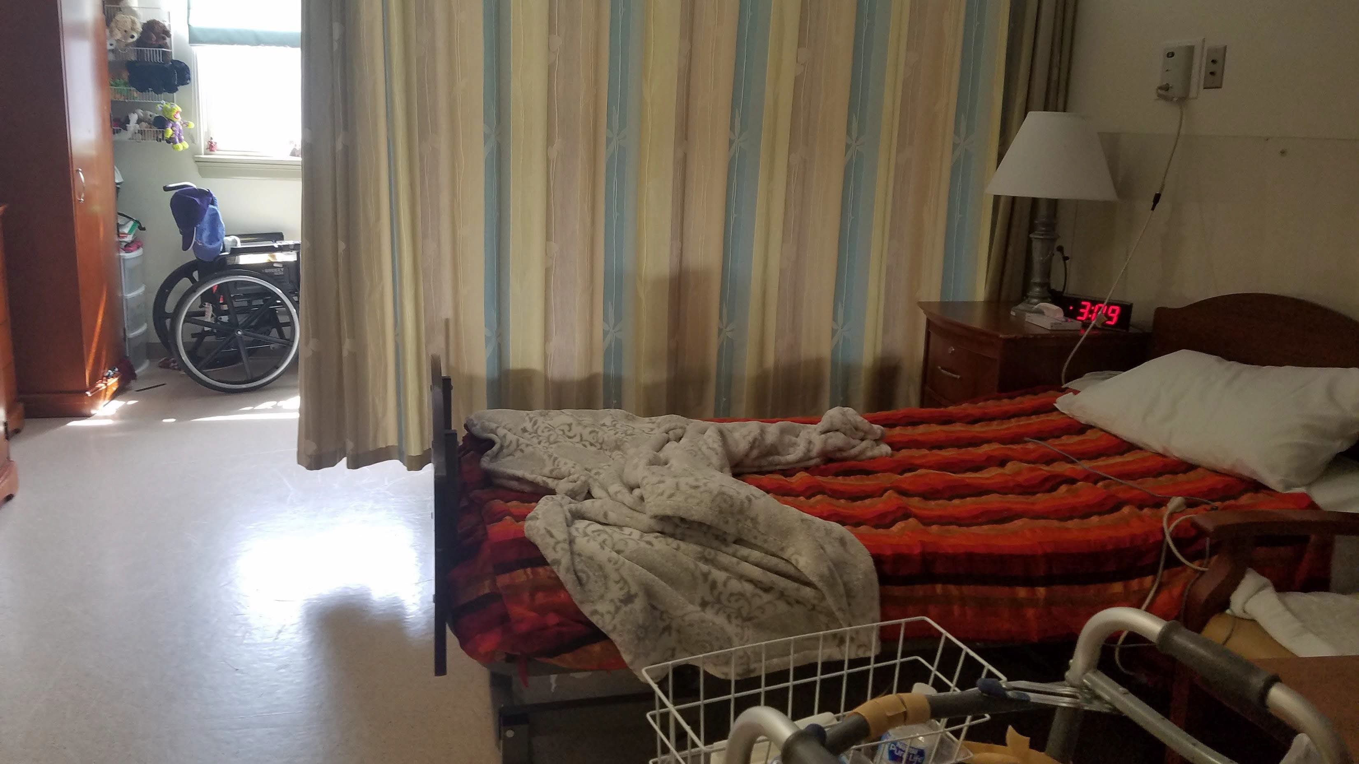
Windemere Today
6

Slide 7
A Green House Bedroom

Slide 8
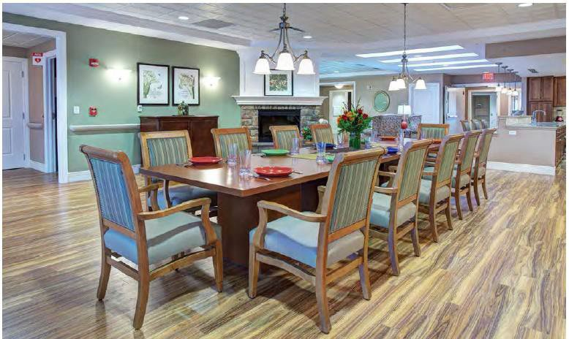
A Green House Common Dining Room
8

Slide 9
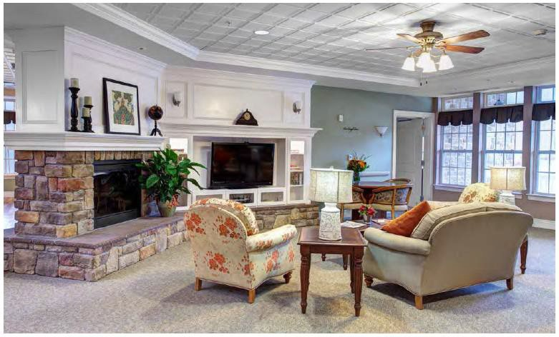
A Green House Common Living Room
9

Slide 10
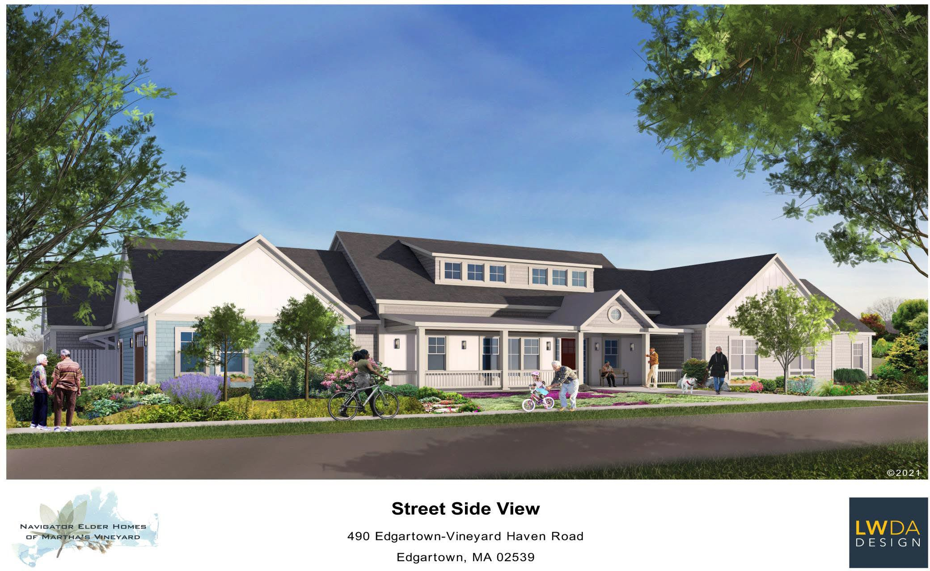
Proposed Green House Residence for Martha’s Vineyard
10

Slide 11
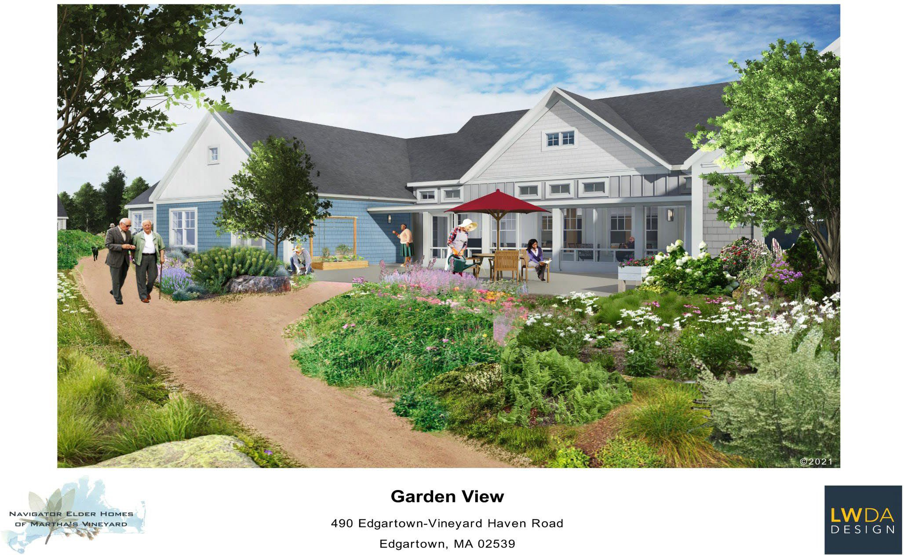
Proposed Garden View of Green House for Martha’s Vineyard
11

Slide 12
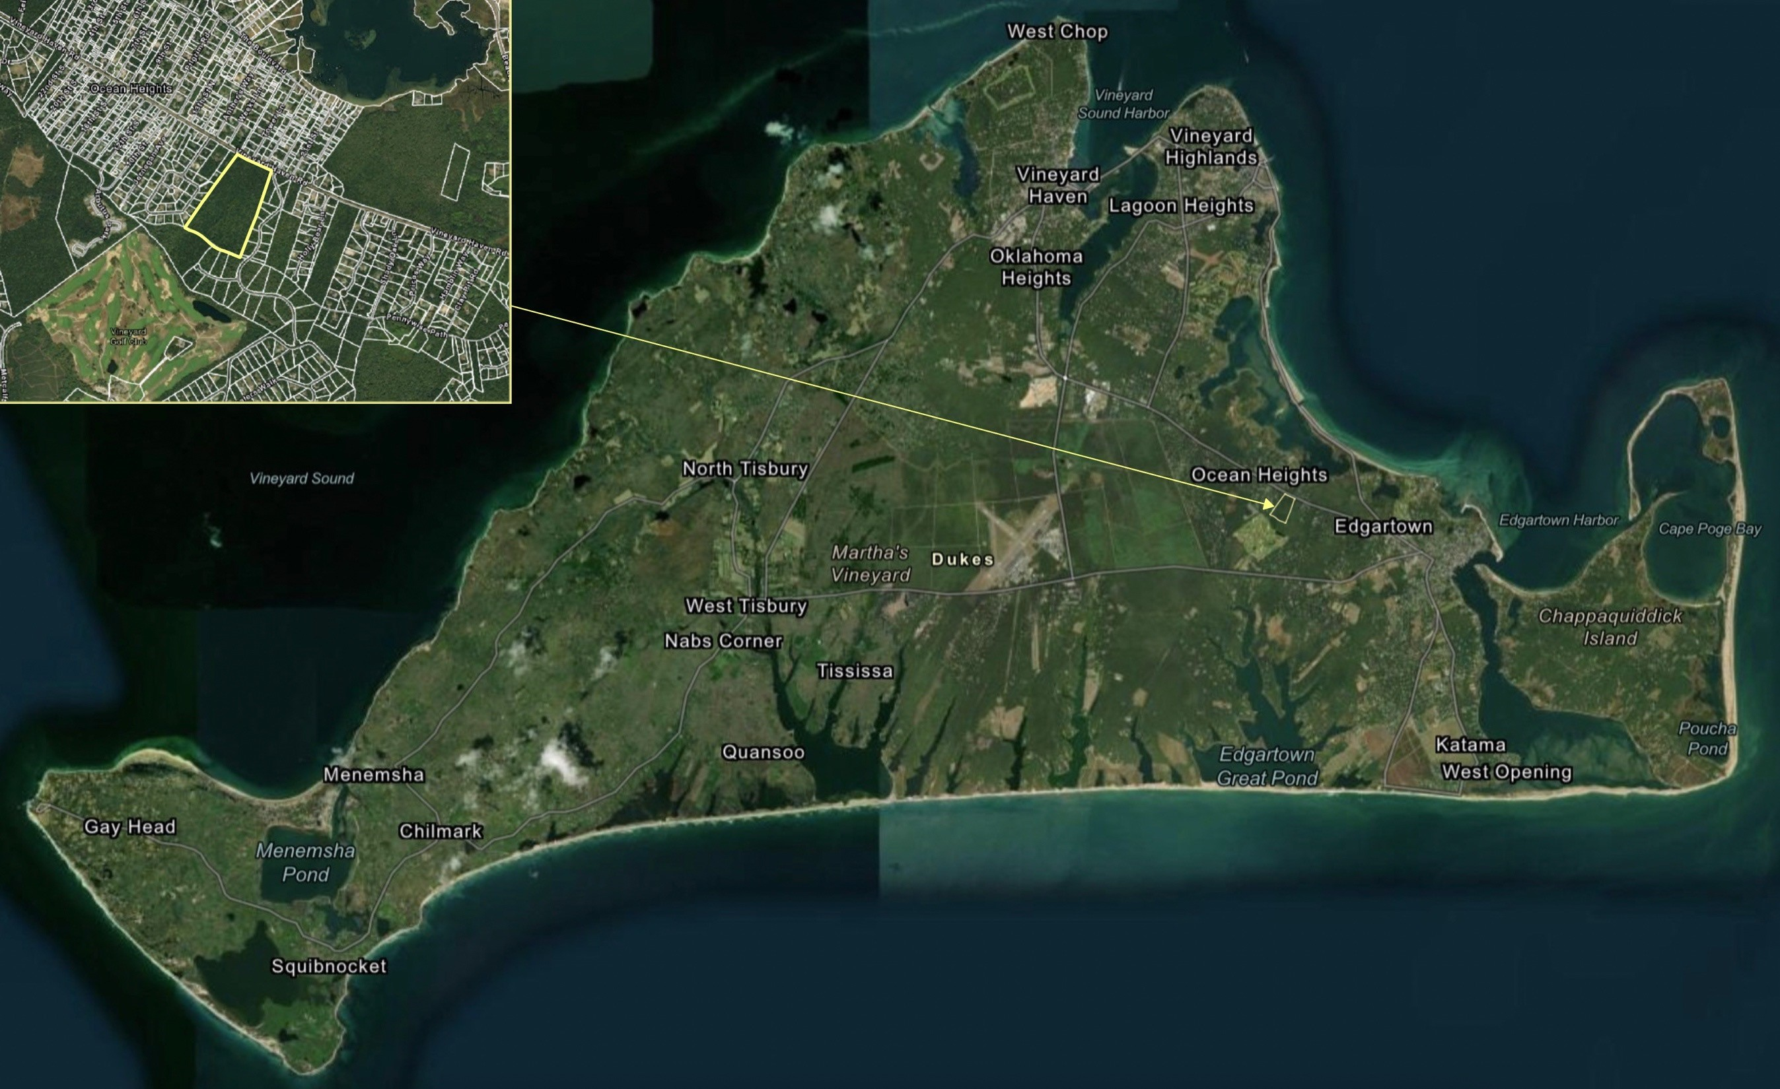
490
EDGARTOWN
-
VINEYARD HAVEN ROAD

Slide 13
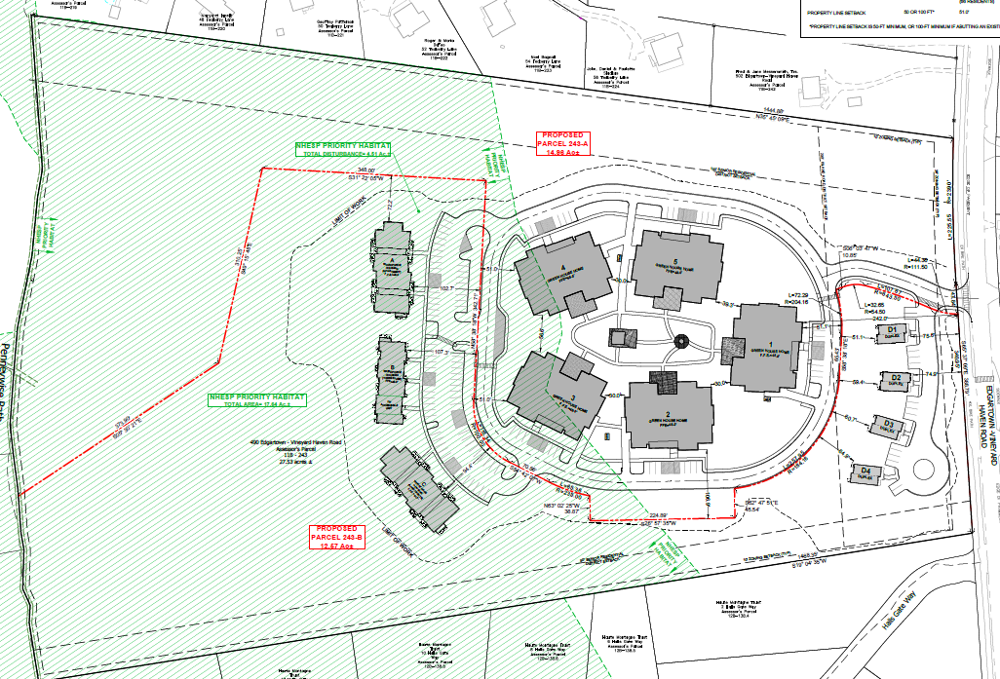
Site Plan
Minimum setback of Building
To lot line West 200
To lot line East 195
Minimum setback of Building
To Building West 245’
Undisturbed area 16.13 acres

Slide 14
Affordability of the Navigator Skilled Nursing Residence
All Windemere Residents will be welcomed into Navigator
Current Windemere demographics:
100% Island Residents
93% with incomes $24,000 or less (=28 of 30 residents)
Average Age is 87
80% Elderly Women
Medicaid Income Eligibility: $24,000,or less/year
No required “Out of Pocket” expenses for Medicaid
61% Navigator Residents to be Medicaid & Medicare Eligible

Slide 15
Affordability of the Navigator Skilled Nursing Residence
Medicaid reimbursements do not cover the cost of care.
A mix of private pay & Medicaid & Medicare will support the financial sustainability of Navigator.
Without this mix you are back to the Windemere financial model, losing $3M/year, and will have no on-Island skilled nursing and only limited rehabilitation services.

Slide 16
Financing Navigator Homes
Total cost: $68 Million
USDA Loan $53 Million
Land: $10 Million
USDA Grant: 0.7 Million
Donations Needed: $5.350 Million
Raised to Date: $5.0 Million
Donations needed: $350,000

Slide 17
In Conclusion
Navigator Homes of Martha’s Vineyard is needed on the Island because otherwise, when Windemere closes, the island will have no skilled nursing care or expanded rehabilitation services.
Navigator Homes needs to raise an additional $350,000 for construction.
When Navigator replaces Windemere, and staff housing is built, then the hospital can expand the health care it will be able to give.
WHEN WE HAVE NAVIGATOR HOMES, WE’LL HAVE BETTER ALL AROUND MEDICAL CARE ON MARTHA’S VINEYARD.

Slide 18
How Can You Help?
Spread the word
Send a donation to Navigator Homes of MV
PO Box 1356, Vineyard Haven, MA 02568
Introduce us to others who might be interested in supporting Navigator Homes
If you’d like to be more involved, contact:
Polly Brown: pollybrown0154@gmail.com
Melinda Loberg: melindaloberg@gmail.com
Paddy Moore: mooreiipaddy@gmail.com
Thank you!

Slide 19
Navigator Homes of MV Board of Directors
David McDonough, President
David Roush, V. President
Mary (Polly) Brown, Treasurer
Melinda Loberg, Secretary
H. Glenn Alberich
Aliya Browne
Maureen Corrigan
Cynthia Hubbard
Patricia (Paddy) Moore

