Slide 1

DCHC Update
07/20/2023
Bill Rovero - MVCS

Slide 2
































Bill Rovero - MVCS

Slide 3
2023 SUDC Strategy
Data Sources
Gaps & Needs Analysis
New
Sub-Committees
Focused on Priorities
From Data
Re-connection &
organization
Introductions
Data Collection
Recommendations
MVCS Off island referrals for detox or other services
IHC Off Island referrals for detox or other services
MVH ER Data and referrals
Red House demographics
Vineyard House statistics
Police data and statistics
New Paths (IOP) enrollments
Coaching enrollments
Bill Rovero - MVCS

Slide 4
The Importance of data & why we are asking for it
In 2021, The Martha’s Vineyard Hospital Emergency Room saw 10,218 visits, of these 706 had a primary or
secondary SUD diagnosis code. This equates to 7% of all ER visits in 2021. Of those 706 visits, 76 were by people
older than age 65.
In 2021, MVH made 31 referrals to off island detox or other treatment facilities
Gosnold - 15
Adcare - 4
Other – 6
No show/Changed mind - 6
IN 2021, MVCS made 64 referrals to off island detox or other treatment facilities
Gosnold – 32
Adcare – 9
Other – 19
No show/Changed mind - 4
In 2021, IHC made XX referrals – Data not available (Jan –June 2023, 33 referrals)
What we know? 706 people sought help for SUD in the ER in 2021. At least 95 people were referred off island
for detox or other treatment. Of those 95 referred, 10 people changed their minds or were a no-show.
12% of people seen in the ER in 2021 received additional aftercare such as off island detox or other services…..
What about the other 88% or those who go without help….
In 2021, Martha’s Vineyard reported 5 opioid related overdoses….

Slide 6
2021 MVCS Referral Data:

Slide 7
2021 MVCS Referral Data:

Slide 8

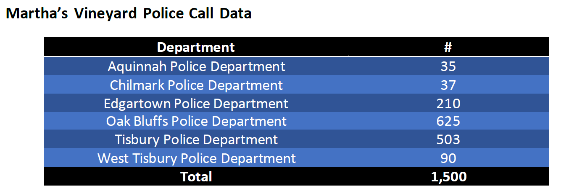
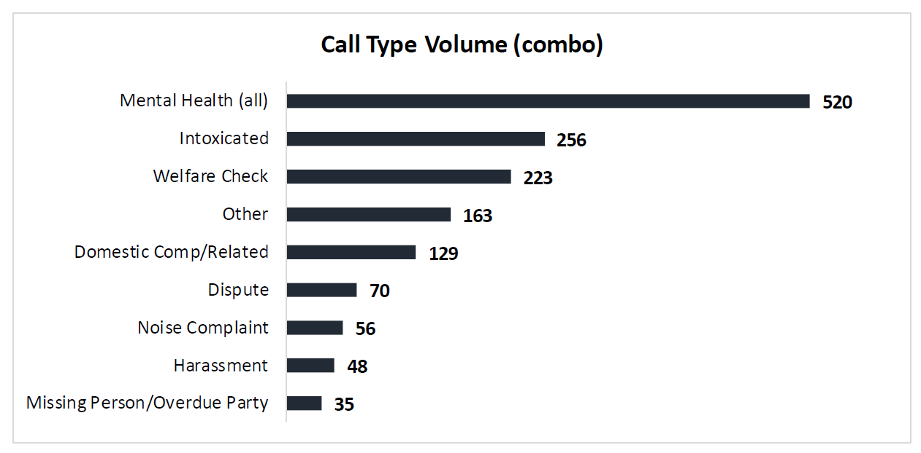
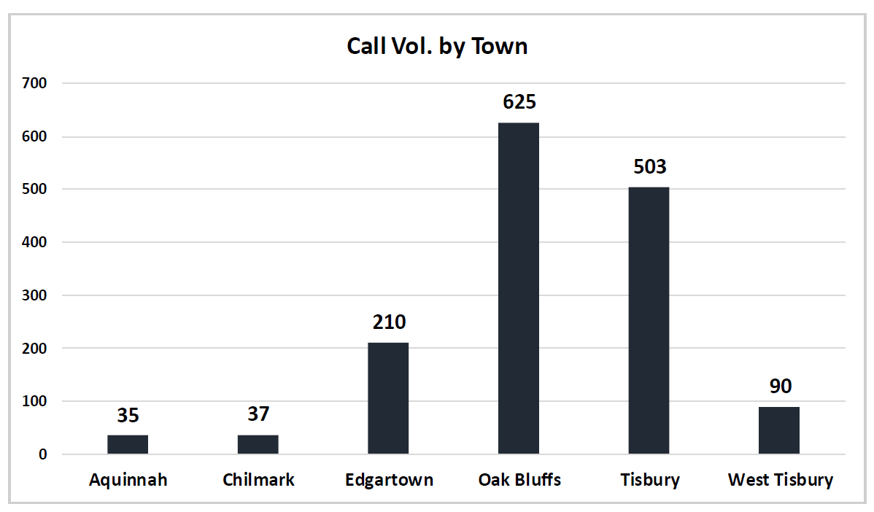
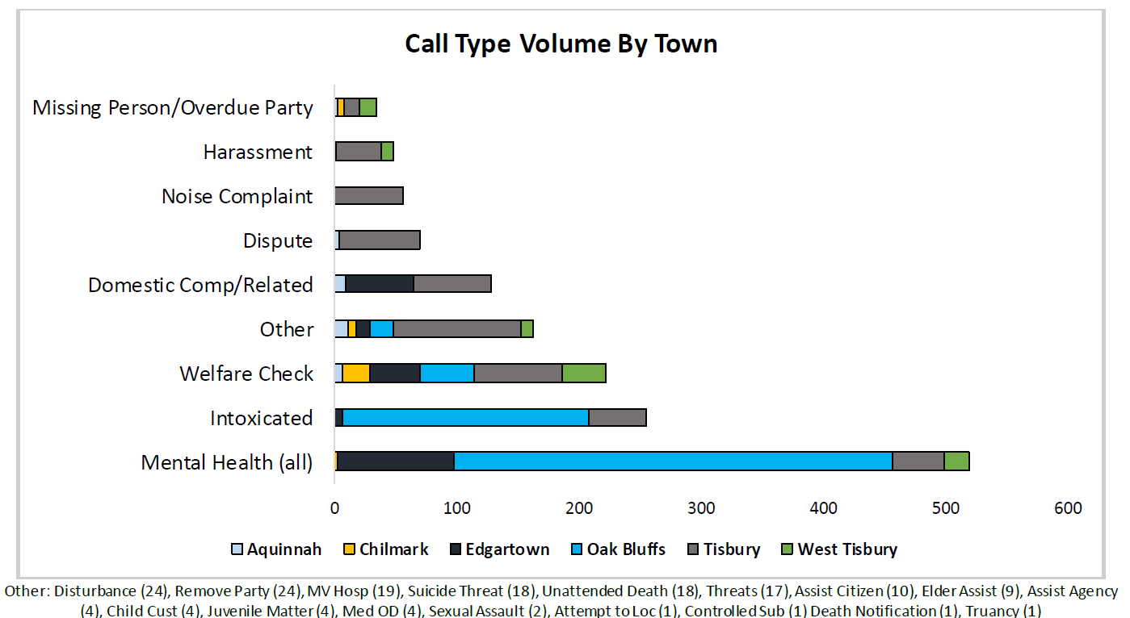
Data covers 2022, Jan - Dec

Slide 9
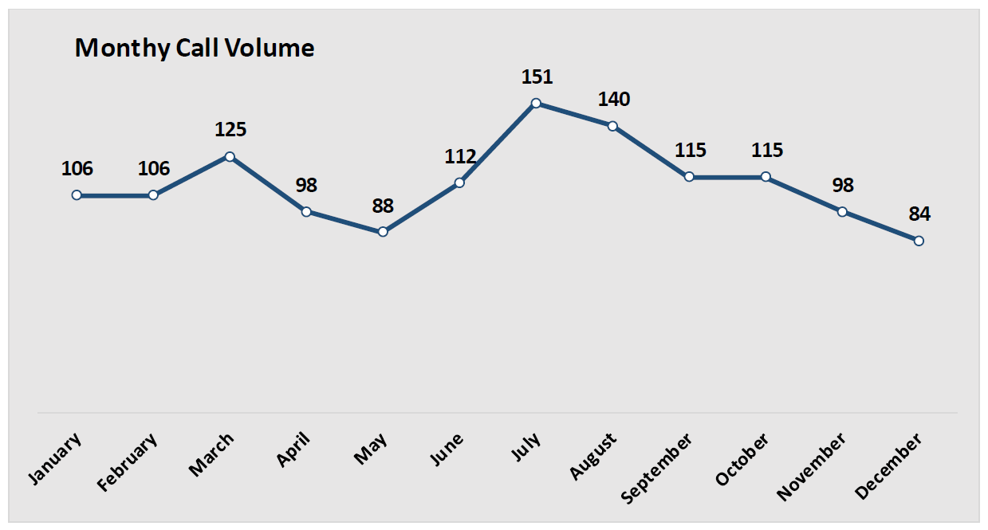
Data covers period of one year
Year Round Population
Approx. 21,000
Seasonal Population
Approx. 80 – 120,000
Year Round Population
Approx. 21,000
Ratio of call volume to population is actually higher in the off-season than at peak seasonal highs
Reflects year round need for Co-Responder program

Slide 10
2023 SUDC Strategy
This is an unprecedented opportunity on the island to make a difference in the SUD landscape here
We need to make our voice heard to ensure that the funds are spent on programs with direct impact
We do that with data, grace, persistence, and patience

Slide 11
National Model
MV Model
Additional Ideation
Community Outreach/Marketing
Additional Sober Living
MV Detox
MV Medically Assisted Treatment
MV Variable Length of Stay Facility
Oxford House
Recovery Ready Workplace
Detox/Rehab “Scholarships”
Red House Expansion
Additional Coaches/Training

