Slide 1
Island Health Care Safety Net Dental Clinic Development
for the Dukes County Health Council
April 13, 2023

Slide 2
Background for Oral Health Services on MV
Vineyard Smiles has long been valiantly addressing the need with on-site pop-ups in schools and senior centers (and continues to do so today)
As long ago as 2018, Oral Health Group considered a Rural Health Scholars study of dental services on the Island
In Fall 2020
Hospital closes safety net dental clinic, citing revenue shortfall
In the months leading up to this, Island dentists identify a large number of Medicare and Medicaid patients who would be without dental services, and many more on the waitlist
People now need to go off-Island for preventive services
Urgent care dental interventions (many for pain) now going to the ER for meds
This group begins to meet to address the concern with immediacy
Island Health Care was invited and identified as a potential location for a pop-up preventive care location
On closer look, the FQHC is the ideal ‘home’ for a safety net dental clinic, so the idea was born.

Slide 3
Why an FQHC Dental Clinic?
The Dental Safety Net—Addressing the Epidemic
“The dental safety net refers to the structures supporting populations facing considerable barriers to accessing dental care. This typically involves individuals without private insurance and/or those who are unable to pay for services out of pocket. The dental safety net is comprised of practitioners, payment programs and facilities that provide clinical, nonclinical and support services. It includes Medicaid, CHIP, federally qualified health centers (FQHCs), school-based health centers and academic dental institutions, among other entities. If not for dental safety net providers, millions more would be without access to dental care”.
American Dental Education Association 2018

Slide 4
Why an FQHC Dental Clinic?
FQHC Dental Clinics serve largely unserved and underserved populations and are reimbursed differently from private dentistry.
FQHCs can also serve other community members with traditional dental insurances or are fee-for-service patients.
IHC offers a sliding-fee mechanism for people to access oral health care.

Slide 5
Island Health Care Oral Health Initiative
IHC reaches out to dental school networks, and through our Chief Medical Officer James Wolff, MD, locates the BU Goldman School of Dental Medicine which agrees to partner in the building and development of a state-of-the-art dental clinic at IHC.
The Goldman School has experience with the FQHC experience in clinic construction, delivering oral health and dental care as well as grant-writing and business structuring of an FQHC dental service
IHC identifies space and begins to develop a proposal to construct and operate a dental clinic

Slide 6
Accomplishments to date
Raised most of the capital funds required to build out the dental clinic from grants, economic development and private funders.
Identified and purchased property in which to put the clinic – Mariner’s Way
Completed clinic architectural drawings and are working on the bidding process
Partnered with the high school Health Assisting Program, MVCET and 4C’s on workforce development for Dental Assistant hiring and training
Secured workforce development funding for the Dental Assisting workforce initiative
Talking to a potential dental director

Slide 7
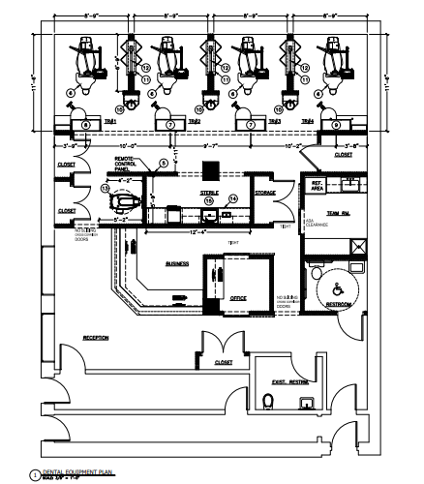
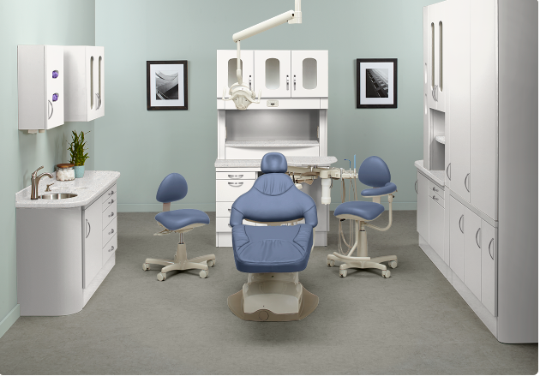
The clinic will look similar to this. Disclaimer on the actual colors!

Slide 8
Projected opening date – January 2024

